Slide 1
2:- Perform K-Means clustering.

Slide 2
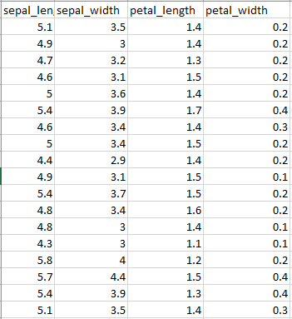
Aim:- You are given an Iris feature dataset, but you don't know which class each data point belongs to.

Slide 3
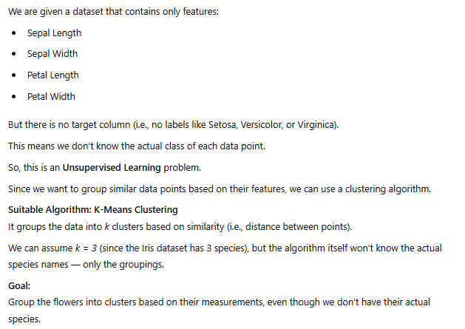

Slide 4
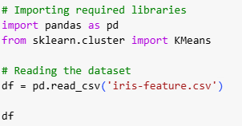


Slide 5

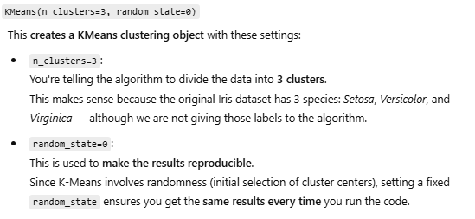


Slide 6


